Slide 1
Teaching Should Be Easier
Assignment 2, Team 2:
Brainstorming and Experience Prototyping

Slide 2
Grading
takes time
Lesson planning
takes time
Meeting with students takes time
Designing around ChatGPT takes time

Slide 3
In teaching,
everything takes time

Slide 4


Lingering Questions
Busywork Which tasks eat up valuable time for little benefit?
Necessary/Valuable Work Which tasks are long because they matter?
Technology’s Role Under what conditions can tech help more than it hurts?

Slide 5
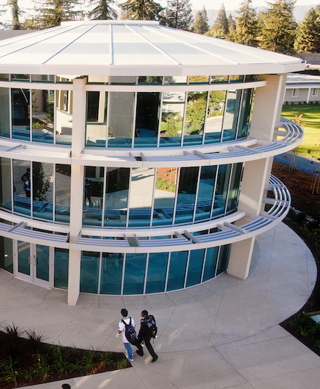
Meet C.
She’s a pioneer of integrating tech into the classroom. She teaches social sciences at the Harker School.
C frequently needs to grade 108 papers in just two weeks.
How does she make it work?

Slide 6
Teachers are forced to give
surface-level
feedback on homework

Slide 7

Meet J.
J is a Stanford alum who teaches English to Japanese middle schoolers.
J spends 1-2 weeks each year solely focused on curricular design.
How does she feel about that?

Slide 8
Lesson planning is
time well spent.
Teachers make good use of existing resources.

Slide 9
POV #1
We met C, a social sciences teacher who loves incorporating technology into the classroom and who works at a well-funded private school in the bay area.
We were surprised to hear she has to grade 108 papers in two weeks
We wonder if this means she is worried that the feedback she is providing is surface level and unable to nurture her students’ growth.
It would be game changing if students could get in-depth feedback on their work without it interfering with her other responsibilities as a teacher like designing lesson plans and meeting one-on-one with students.

Slide 10
POV #2
We met T, a high school teacher at a parent partnership homeschooling program who needs to assign lots of asynchronous work to her students since she only sees them one day per week.
We were surprised to hear it is impossible to prove when students are using ChatGPT.
We wonder if this means that teachers are forced to change the kinds of assignments they give in order to prevent students from using AI.
It would be game-changing for teachers to not have to worry about students using AI to cheat.

Slide 11
POV #3
We met M, a science teacher at a well-funded private school in the bay area.
We were surprised to hear students waited in his room for an hour after school to meet with him.
We wonder if this means students don’t know when their teacher will be available to meet with them and are afraid they’ll miss their opportunity.
It would be game-changing for students to not worry about missing their opportunity while making use of the time they spend waiting for their turn.

Slide 12
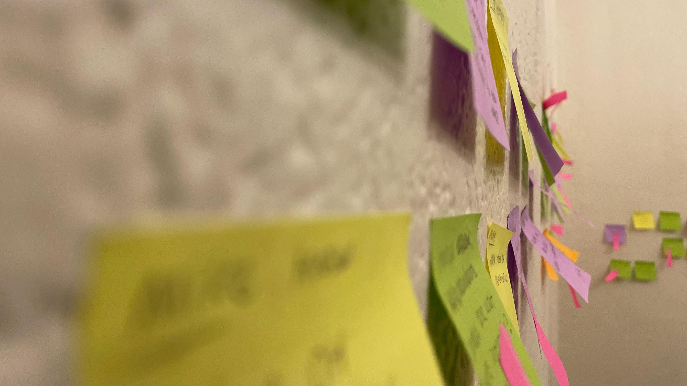
HMWs
It would be game-changing for students to not worry about missing their opportunity while making use of the time they spend waiting for their turn.
HMW make the wait for office hours just as much an opportunity for learning as the time spent with the teacher themself?
It would be game-changing for teachers to not have to worry about students using AI to cheat.
HMW allow students to document their writing process and progress throughout an assignment?
It would be game changing if students could get in-depth feedback on their work without it interfering with her other responsibilities as a teacher like designing lesson plans and meeting one-on-one with students.
HMW direct the teachers' attention to the assignments that need the most help?

Slide 13
HMW make the wait for office hours just as much an opportunity for learning as the time spent with the teacher themself?
Group students with the same question together, and notify them when they reach the front of the queue

Slide 14
Underlying assumption:
Many students with the same question show up at different times and spend a long time unproductively waiting for an answer.

Slide 15
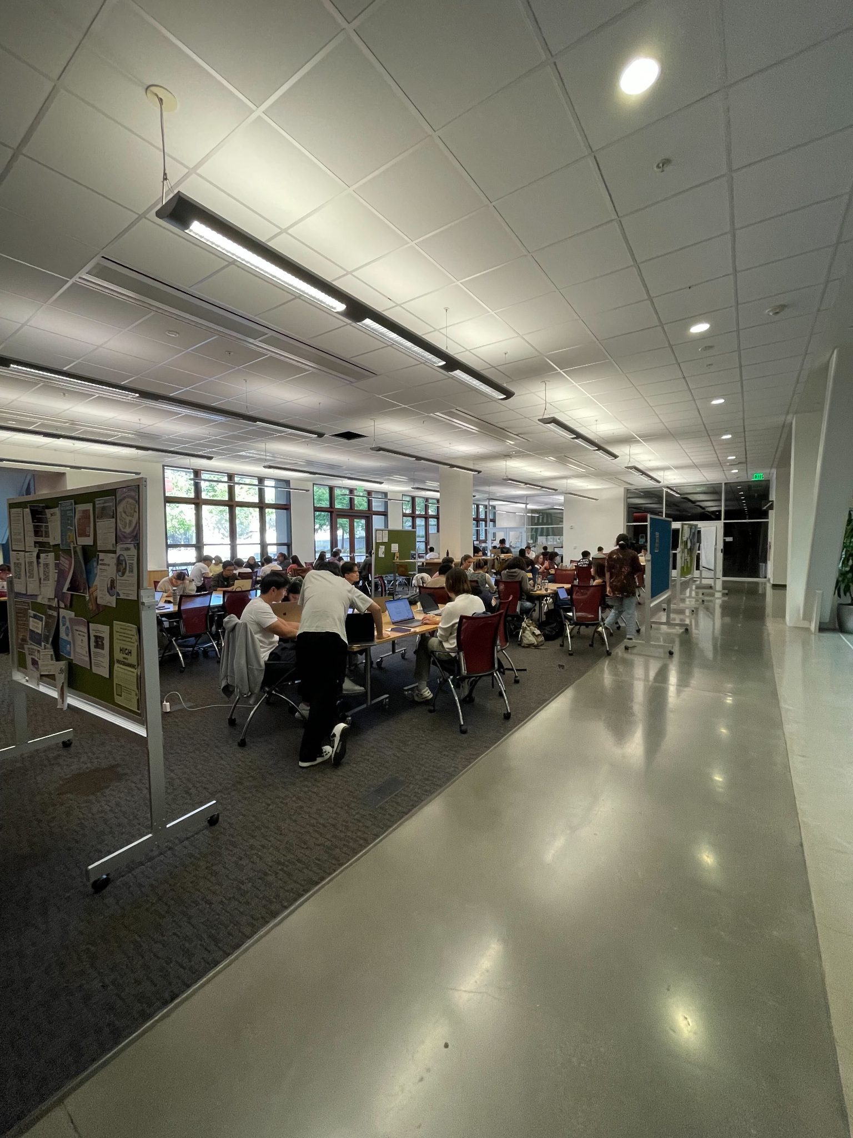
Our test: Interviews
66%
had been waiting for longer than 30 minutes.
100%
identified a single question lots of people needed help on.
100%
had worked with others there to solve their problem.

Slide 16
The assumption was partially valid.
Wait times were long and many had the same question, but most were able to get help from peers on their own.

Slide 17
HMW allow students to document their writing process and progress throughout an assignment?
Build a system that supports an iterative writing process where all changes are tracked. Students are required to outline, revise, and reflect on their writing.

Slide 18
Underlying assumption:
It is more helpful than burdensome to force students to use a formal writing process.

Slide 19
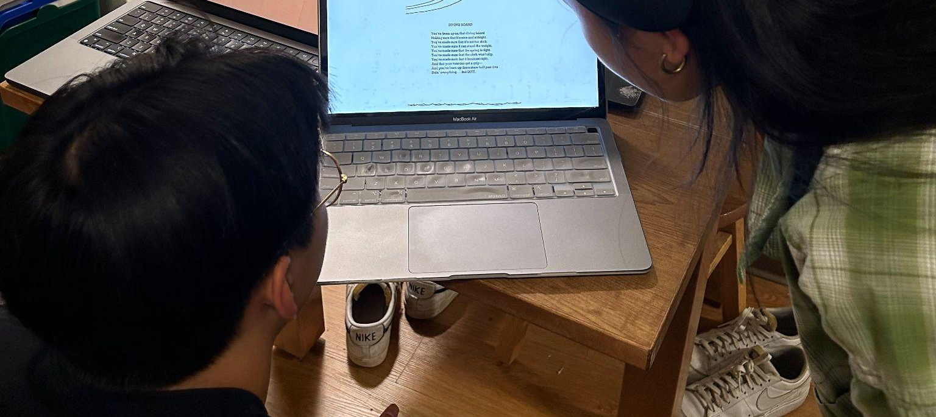
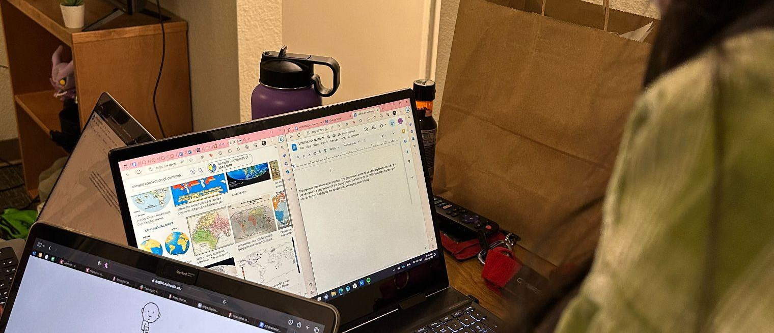
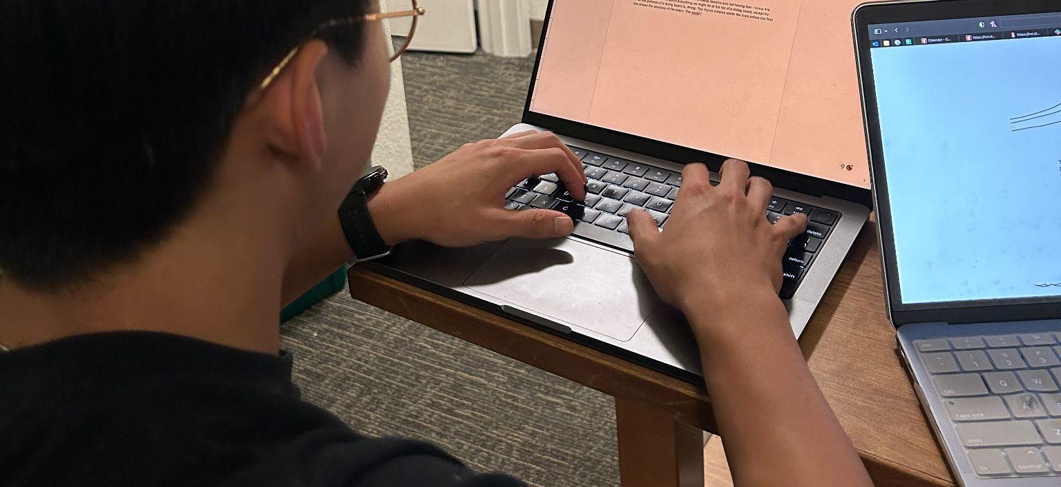
Our test: Workshop
L: “[the second process] feels like more formatted and easier to think versus your ideas in the first one are kinda like everywhere.“
S: “...I don't understand my own thoughts [during free writes]...”
Notes:
Process 1: 7 minute free write
Process 2: 2 minutes writing thesis, 5 minutes finishing paragraph, 5 minutes revising
Changes from initial plan:
Changed Poem 2 to simpler poem (initial Poem 2 was much more difficult to understand/interpret than Poem 1)
Allowed participants to read poem for as long as they needed before writing
Allowed participants to reference poem throughout writing process
Participant information:
S, a Stanford student majoring in EE, doesn’t consider themself a strong writer, indifferent about writing, doesn’t prefer writing assignments
L, a pre-med Stanford, considers themself a decently strong writer, enjoys writing, doesn’t have a preference for assignment type

Slide 20
The assumption was valid.
While being forced to use a formal process created upfront stress, participants preferred it in hindsight.

Slide 21
HMW direct the teachers' attention to the assignments that need the most help?
Make peer grading easier and allow students to flag assignments that need help. Identify which students’ opinions to trust most over time.

Slide 22
Underlying assumption:
Peers can reliably identify which assignments need the most help from a teacher.

Slide 23
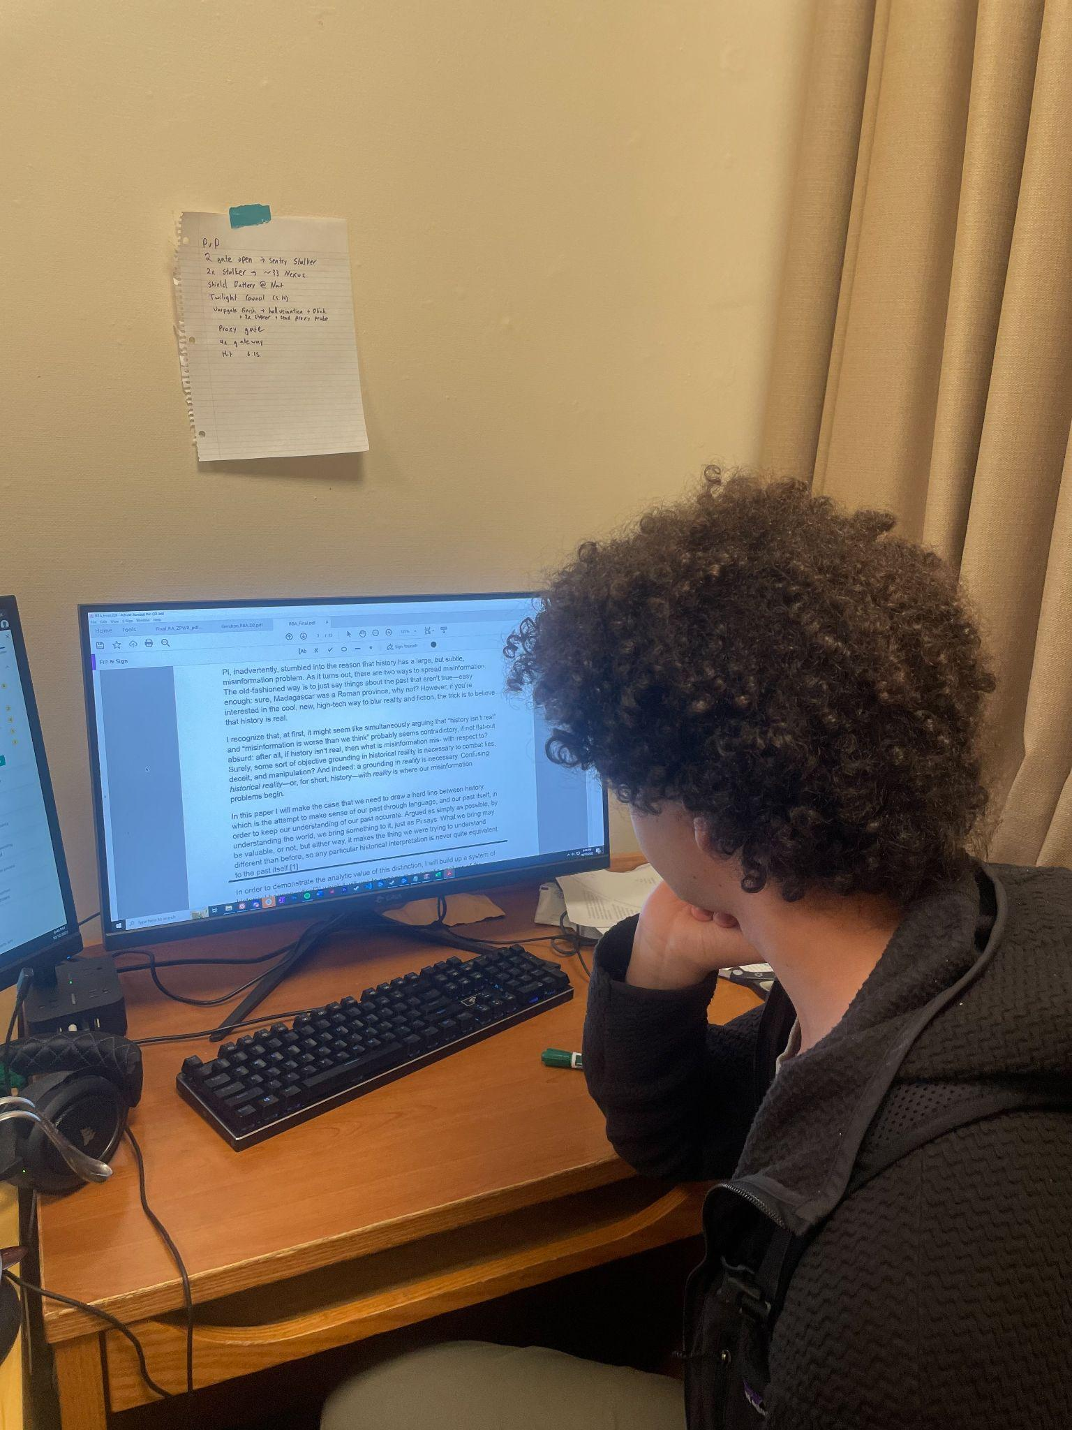
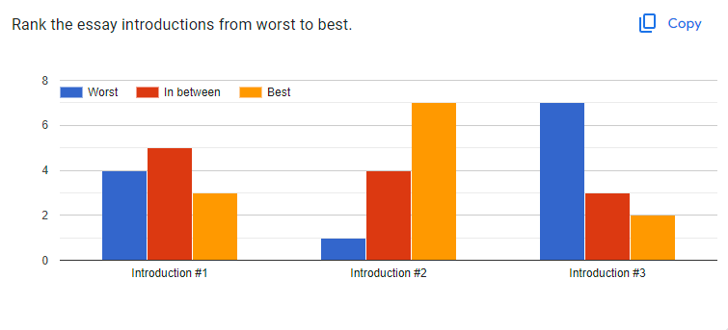
Our test: Experiment
12 participants ranked the quality of the introduction to 3 PWR RBAs.
Notes:
Process 1: 7 minute free write
Process 2: 2 minutes writing thesis, 5 minutes finishing paragraph, 5 minutes revising
Changes from initial plan:
Changed Poem 2 to simpler poem (initial Poem 2 was much more difficult to understand/interpret than Poem 1)
Allowed participants to read poem for as long as they needed before writing
Allowed participants to reference poem throughout writing process
Participant information:
S, a Stanford student majoring in EE, doesn’t consider themself a strong writer, indifferent about writing, doesn’t prefer writing assignments
L, a pre-med Stanford, considers themself a decently strong writer, enjoys writing, doesn’t have a preference for assignment type

Slide 24
The assumption was valid.
While different writing styles made comparison tricky, there was a clear consensus on the best and worst introductions.

Slide 25
Going Forward
Participant Bias Is everything easier with Stanford students?
Who’s left behind? Many students lack access to reliable internet.
Choosing a Solution They all look potentially viable—we’d love to hear your thoughts!

Slide 26
Appendix A: Solutions
HMW make the wait for office hours just as much an opportunity for learning as the time spent with the teacher themself?
Solutions:
Create groups during the wait time of OH/tutoring to spend time working on similar problems with classmates ➕ 🍜🥽
Notify students who are waiting for a specific problem that the teacher is also working on with another student to listen in ➕🥽
Notify students when their turn is next ➕ 👍🥽
Group students with different questions together for peer teaching ➕🥽
Group students with the same question to ask the teacher together👍➕🥽
Prompt students with the same problem to discuss with one another
Pinpoint the exact misunderstanding by giving them work while they wait
Connect students with peer advisors and volunteer tutors who give information to teachers on what caused the student confusion.
Let teachers quantify what students need help with
Integrate office hours into normal lesson time
Record office hours so students with the same question can watch the explanation 👍➕
Divide up office hours time on the basis of topic area so students can come even if they don’t have a specific question just general confusion.
Have students complete a short write-up about their office hours content so other students can use it after ➕ 🍜
Let students chat/make group chats with other students at office hours ➕
“Make sure you know it’s your turn so you get to focus on other things (and other learning) before/after” 👍🥽
Know who else is struggling with same problem, get them together (digital, or physical)🥽
Know who has already solved
Group students with the same question to ask the teacher together, and notify them when they reach the front of the queue👍➕🥽
HMW allow students to document their writing process and progress throughout an assignment?
Solutions:
System for iterative writing process where all changes are tracked– prompts along the way, short questions for comprehension/sanity checks, etc. ➕ 👍 🍜
System where all work is documented and visible but only the final work is submitted 🥽
Submit Individual parts of the writing process for evaluation to teacher, and then at the end stitch each part together to create the final paper ➕ 🍜
Allow teachers to watch students write live
Force students to submit process
Prompt students to revise their work
Track all editing and detect copying
Help teachers share writing prompts ChatGPT can’t replicate
Voice-Recorded Logs: Introduce a feature that allows students to record voice memos where they discuss their ideas, challenges, and breakthroughs while working on the assignment. These recordings could be submitted alongside their final work. ➕ 👍
Organize writing competitions/challenges throughout an assignment
Have an AI ask students questions about their essay after they have submitted it
HMW direct the teachers' attention to the assignments that need the most help?
Solutions:
Outsource grading to experts in the specific area to free teacher’s time ➕🍜
Incentivize grading
Peer grading ➕🥽
System for students to flag their work if need feedback 👍➕
Sort Papers/Assignments to be graded based on student’s overall grade (First look is more important than last look) 🍜
Randomly assign and rotate through students 👍
Enable students and teacher to review assignments
Detect the general quality of work using AI
Enable external experts or older peers to grade
Focus students on skill and portfolio building rather than perfect scores
Tool that makes pier grading more easy and ranks quality of peer grades so teachers over time can rely on certain graders more! 👍🥽
Is it possible for AI to do the surface-level feedback?

Slide 27
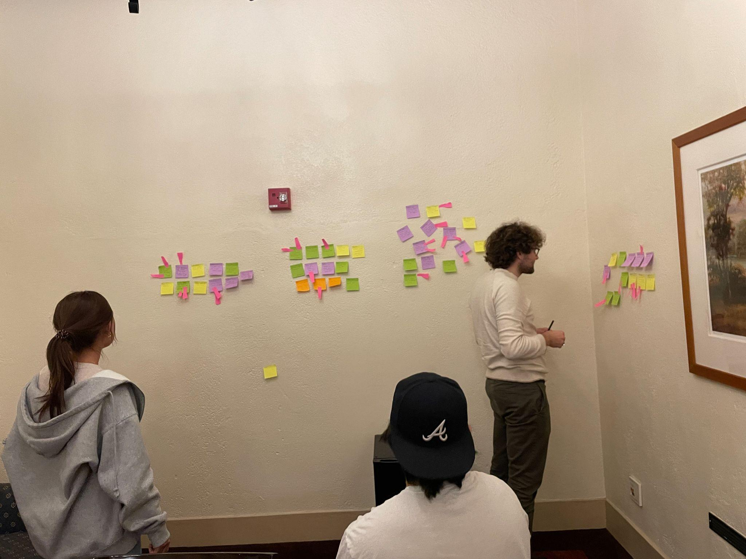
Appendix B: HMWs
Used a physical sticky note wall and heat-map voting.
Some POVs were much easier to generate lots of solutions for than others.
Wound up generating four POVs and then picking 3 after creating our HMWs.

Slide 28

Appendix C: Peer Grading Test
https://docs.google.com/forms/d/1Q_8Z3Vx9GXDykVuHjTUSQVZI6AmvMxxDauOUYv9msdg/edit
Participant information: 12 stanford students, sourced from the debate team and Toyon hall.
What worked: Many participants felt very confident in their answers. The only bottleneck on time was reading speed.
What didn’t: Other participants were unclear on what “best” was across different writing styles.
New learnings: Consensus emerged, but it will require multiple reviews of each essay for clear data.

Slide 29
Appendix D: Office Hours Test
Asked People at OH
Question 1: Have you been waiting for help at OH for longer than 30 Minutes
Question 2: Have you noticed there is a specific problem that a lot of people are asking for help on?
Question 3: Have you worked with anyone else at the table to solve a problem?
Participant 1:
Yes
Yes
Yes
Observations
They were upset and annoyed that they were waiting for a long time at office hours
They stopped working and were on their phone waiting for their turn
Key point: There is a lot of valuable time being wasted at OH that could be used for more productive work
They collaborated with another individual at OH
Key point: Students on their own ask for help from others
Participant 2:
No
Yes
Yes
Observations
They had just arrived to OH and had a question ready for the TA, but were upset because they were at the back of the queue for help
They spent most of their time at OH working on the problem that they were struggling with.
They would spend time trying to listen to the TA help other students on the same problem they were also stuck on.
Participant 3:
Yes
Yes
Yes
Observations
They were almost next in line for individual help at OH.
They noticed that another person had the same problem as they did so they listened and got help, not they think they are closer to solving the problem and will finish with the TA’s help
Key point: Indirect Group collaboration helped the student achieve more during their wait in the queue.
They did not collaborate with another student because they were listening to advice from the TA when they were helping someone else.

Slide 30
Appendix E: Structured Writing Test
Assumption: It is more helpful than burdensome to force writers to use a formal writing process.
Result: Assumption was VALID
Test: Gather two students. Make them first write in freeform using one prompt. Then, ask them to write using a formal structure with a new prompt. Interview them about their experience.
Poem 1: Describe the message of the poem and your interpretation.
Divingboardshel.jpg
Poem 2: Describe the message of the poem and your interpretation.
322e0e97d1baa6789d95b00af2660474.jpg
Participant information:
S, a Stanford student majoring in EE, doesn’t consider themself a strong writer, indifferent about writing, doesn’t prefer writing assignments
L, a pre-med Stanford, considers themself a decently strong writer, enjoys writing, doesn’t have a preference for assignment type
Recruited as friends of group members
Relevance of participants: Different writing strengths, different attitudes toward writing, different majors that require different levels/amounts of writing
What worked:
Letting the participants reference poem before and throughout the writing processes
Picking a simpler poem for poem 2 (equal to reading/comprehension level of poem 1)
Picking poem images with images – evoked positive emotions from participants
Switching the prompt
Participants were excited to read Shel Silverstein poems, said it reminded them of their childhood, said they recognized the author/image styles
What didn’t work:
Time limit put pressure on participants – would it have been better to let them write for as long as they needed?
Participants didn’t know how to respond to initial prompt “Describe the literary devices and how they make the poem effective.”
Didn’t remember what literary devices are
For writing process 2, participants shared that it was difficult to not be able to go back and revise the thesis while they wrote the rest of the paragraph
L shared that they personally write the thesis after the details
S shared that they personally write the thesis first
New learnings:
Writing process 2 evoked a lot of upfront stress – does the end result outweigh the initial negative reaction to structured writing?
S said they were taught to use the second writing process throughout school (attended school outside Atlanta, GA)
Participants were excited to write after hearing about prompt and poem choices – do the writing topics serve as a greater motivation and result in better work than a structured writing process alone?
Going forward:Q&A:
Which writing process was easier? Which did you prefer?
S: second, same as lindsay
L: second, feels like more formatted and easier to think versus your ideas in the first one are kinda like everywhere
Which writing process do you use?
S: Second, my free write is ass, I don't understand my own thoughts, I write my thesis first, I model everything around my thesis
L: Second, I do it in the opposite way, I write, see what I write about, then I go back to write the thesis
Do you think your final work would be better with final process
S: yes, thats what they teach us in school
L: breaking down in parts is easier versus writing the whole thing
Notes:
Free write observations:
- participants didn’t remember how to respond to original prompt
- participants referenced poem throughout writing
- participants began strong by writing a sentence or two without looking back at poem
- participants wrote a sentence or two, got stuck
- participants needed time to think throughout writing process
- participants felt like poem was too short/simple
- stan finished in 3 min, lindsay had 3 sentences when he finished
- stan said “I have no thoughts”
- lindsay referenced poem a lot more during writing process
- lindsay needed to put on her headphones to focus
- lindsay finished in 6 min
Structured writing observations:
- stan felt like second poem was more difficult, had to think about it more before writing
- 2 min thesis
- 5 min rest of paragraph
- 5 min revision
- had to change poem to simpler one
- stan forgot what a thesis is
- lindsay finished thesis
- both revised thesis a lot during slotted time
- lindsay finished thesis with 0:30 left
- stan finished thesis with 1 min left
- participants had a slow start to writing the rest of the paragraph after thesis
- stan finished second part with 1 minute left
- lindsay finished second part with 30 sec left
- stan felt like he didn’t know where to make any edits
- lindsay asked if they could revise their thesis
- lindsay spent a lot of time rereading her precious work
- lindsay finished revising with 2:22 left
- stan finished with 2:14 left

